Slide 1

Java Script

Slide 2


Do You Know?

Slide 3
What is JavaScript ?
JavaScript is the programming language of HTML and the Web.It makes web page dynamic.It is an interpreted programming language with object-oriented capabilities.
JavaScript is a Client side Programming language.

Slide 4
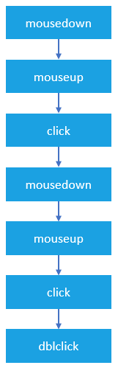
Why We Learn JavaScript?
JavaScript is a Event Based programming language.

Slide 5
Benefits of learning JavaScript:-
Jquery 1.Electron js 1.Angular Js
Angular Js 2.ReactJs
React Js 3.NodeJs
vueJs 4.React Navigate
NodeJs 5.VueJs
Web Development
Desktop App Development
Mobile App Development

Slide 6
JavaScript Implementation:-
2 Ways to Implment JavaScript:
Inline JavaScript
External JavaScript

Slide 7
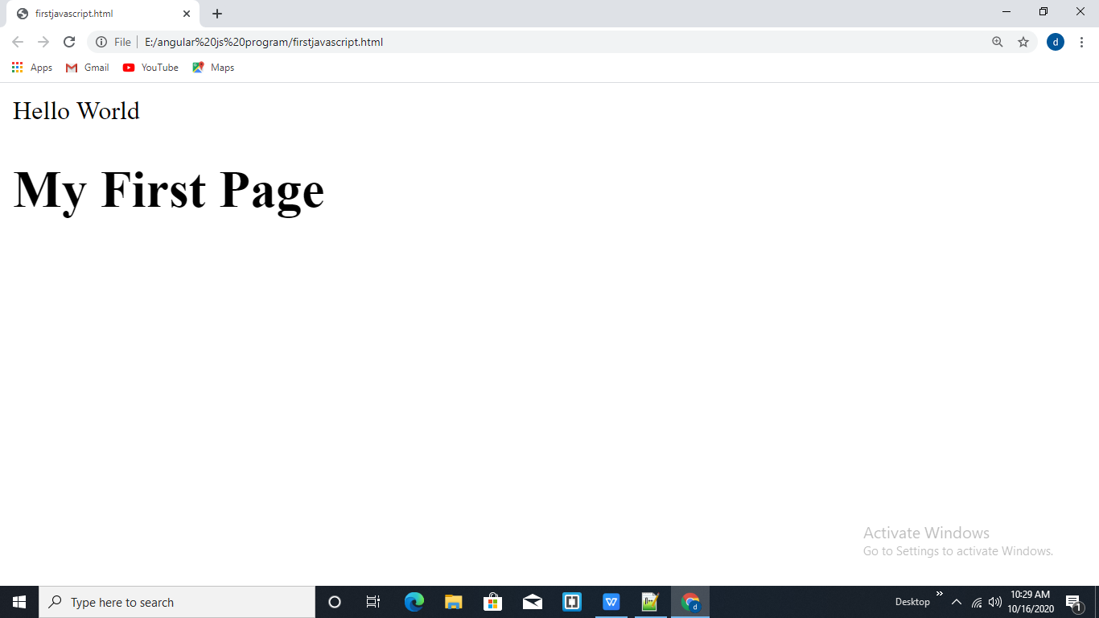
Inline JavaScript:
<html>
<head>
<script>
document.write(“Hello World”);
</script>
</head>
<body>
<h1>My First Page</h1>
</body>
</html>
<script>
</script>

Slide 8
External JavaScript:
<html>
<head>
<script src=”demo.js”>
</script>
</head>
<body>
<h1>My First Page</h1>
</body>
</html>

Slide 9
JavaScript Variables:
A varibales is an identifier or name which is used to refer a value.A variable is written with a combination of letters,numbers,and special character_(underscore) and $(dollar) with the first letter begin alphabet.
Ex: c,fact,b33,total_amount etc..;
How to use Variables:
Var
Let
Const

Slide 10
Rules:-
Variables can contain combination of letter,digits,underscores(_),and dollar signs($).
Must begin with a letter A-Z or a-z or underscore or dollar sign.
A variable name cannot start with an number.
Must not contain any space characters.
JavaScript is case sensitive.
Can't use reserved keywords,

Slide 11
Ex: Var
<html>
<head>
<script>
var a=”India Is My Country”;
document.write(a);
document.write('a');
</script>
</head>
<body>
</body>
</html>

Slide 12
Ex: Let
<html>
<head>
<script>
let a=”India Is My Country”;
let a=”Hello”;
document.write(a);
</script>
</head>
<body>
</body>
</html>

Slide 13
Ex:Const
<html>
<head>
<script>
const a=”India Is My Country”;
document.write(a);
</script>
</head>
<body>
</body>
</html>

Slide 14
Difference between Variable Type:
var x=”hello”; let x=”hello”; const x=”hello”;
var x=”World”; let x=”world”; const x=”hii”;
x=”Hii”; x=”hii”; x=”hii”;
Var
Let
Const

Slide 15
Difference Type Of Data Types:
var x=”hello”; String
var x=25; Number
var x=true; Boolean
var x=[“deep”,”jay”,”kavan”]; Array
var x={first:”deep”,last:”patel”}; Object
var x=null; Null
var x; Undefined

Slide 16
Java Script Operator:-
Arithmetic Operator
Relational Operator
Logical Operator
Bitwise Operator
Assignment Operator
increment or decrement Operator

Slide 17
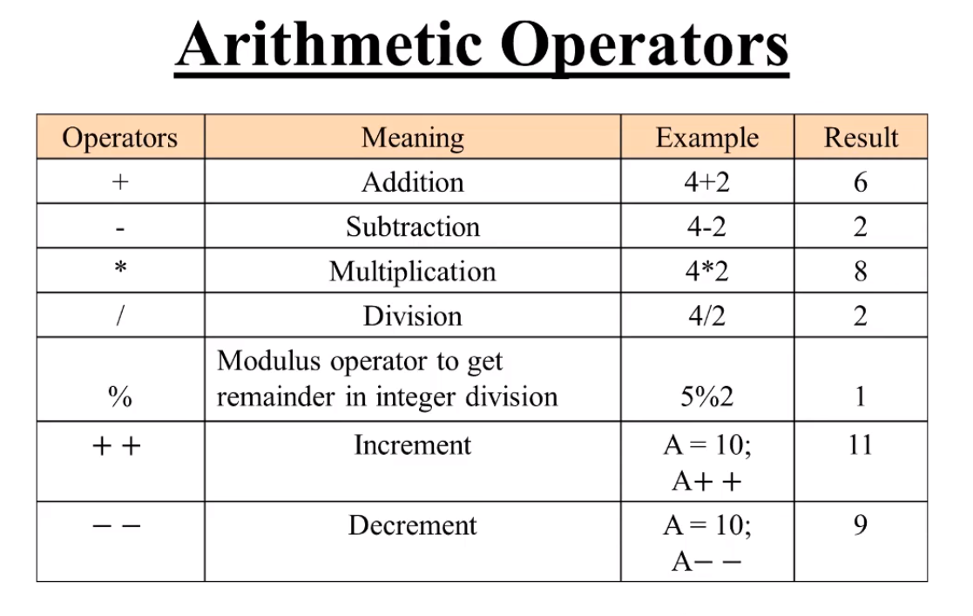
Arithmetic Operator:-

Slide 18
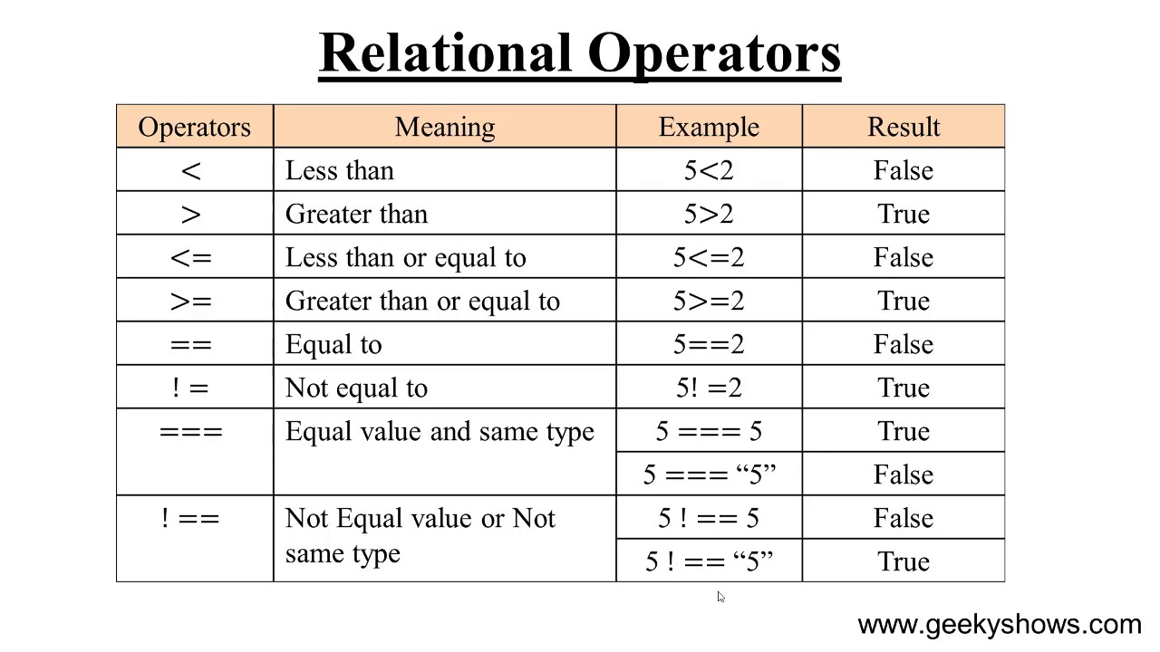
Relational Operator:-

Slide 19
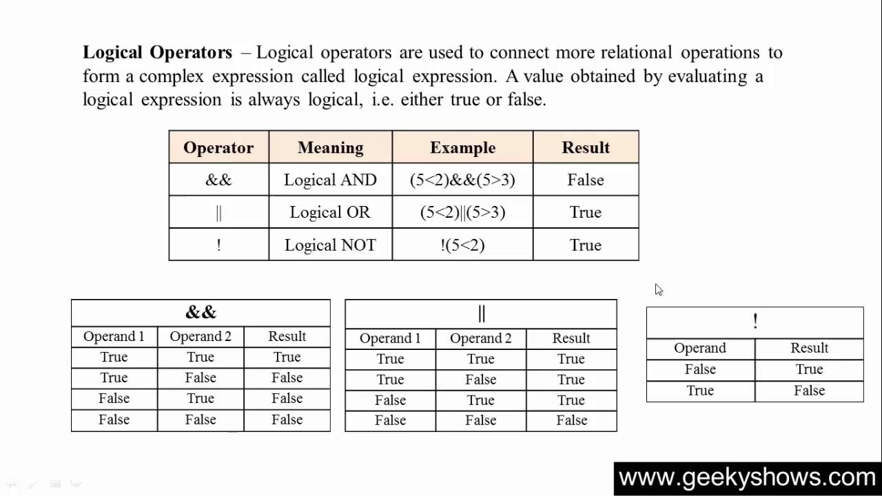
Logical Operator:-

Slide 20
Control Statement:-
If Statement
If else Statement
else If Statement
Switch Statement

Slide 21
If Statement:-
It is used to execute an instruction or block of instruction only if a condition is fulfiled.
Syntax:-
if(condition)
{
block of statement;
}

Slide 22
Ex:-
<html>
<head>
<script>
var a=10;
if(a==10)
{
document.write(“a value is”,+a);
}
document.write(“wrong condition”);
</script>
</head>
<body>
</body>
</html>

Slide 23
If else Statement:-
if...else statement is used when different sequence of instruction is to be excuted depending on the logical value(true/false) of the condition evaluated.
Syntax:-
if(condition)
{
statement_ 1_Block;
}
else
{
statement_ 2_Block;
}

Slide 24
Ex:-
<html>
<head>
<script>
var a=10;
if(a%2==0)
{
document.write(“Even no”);
}
else
{
document.write(“Odd no”);
}
</script>
</head>
<body>
</body>
</html>

Slide 25
Else If Statement:-
To show a multi-way decision based on several conditions,we use else if statement.
Syntax:-
if(condition_1)
{
statement_1_Block;
}
else if(condition_2)
{
statement_2_Block;
}
else if(condition_n)
{
statement_n_Block;
}
else
statement_x;

Slide 26
Ex:-
<html>
<head>
<script>
var result=18;
if(result <=30)
{
document.write(“fail”);
}
else if(result <=50)
{
document.write(“pass”);
}
else {
document.write(“wrong”);
}
</script>
</head>
<body>
</body>
</html>

Slide 27
Switch Statement:-
Check several possible constant values for an expression.
Syntax:-
switch(expression)
{
case expression 1:
block of statement 1;
break;
case expression 2:
block of statement 2;
break;
default:
default block of instruction;
}

Slide 28
Ex:-
<html>
<head>
<script>
var day=1;
switch(day)
{
case 1:
document.write(“sun”);
break;
case 2:
document.write(“Mon”);
break;
default:
document.write(“wrong);
</script>
</head>
<body>
</body>
</html>

Slide 29
Looping Statement:-
For Loop
While Loop
Do While Loop

Slide 30
For Loop:-
The for loop is frequently used,usually where the loop will be traversed a fixed number of times.
Syntax:-
for(initialization; test condition; increment or decrement)
{
block of statement;
}

Slide 31
Ex:-
<html>
<head>
<script>
for(i=0;i<=5;i++)
{
document.write(i+,”<br>”);
}
</script>
</head>
<body>
</body>
</html>

Slide 32
While loop:-
The while loop keeps repeating an action until an associated condition returnns false.
This is a entry control loop.
syntax:-
while(test conndition)
{
body of the loop;
increment/decrement;
}

Slide 33
Ex:-
<html>
<head>
<script>
var a=0;
while(a<0)
{
document.write(i);
i++;
document.write(“<br>”);
}
</script>
</head>
<body>
</body>
</html>

Slide 34
Do While Loop:-
The do while loop is similar to while loop,but the condition is checked after the loop body is executed.this ensure that the loop body is run at least once.
This is a exit control loop.
syntax:-
do
{
statement;
}
while(test condition);

Slide 35
Ex:-
<html>
<head>
<script>
var a=0;
do
{
document.write(a);
a++;
document.write(“<br>”);
}
while(a<5);
</script>
</head>
<body>
</body>
</html>

Slide 36
Function:-
Function are subprogram which are used to cmputer a value or perform a task.
Type of Function
- Library or built in functions
ex.alert(),write(),prompt() etc..
- user defined function

Slide 37
Creating and Calling a Function:-
Creating & Calling Function
syntax:-
function function_name() // function declaration
{
block of statement;
}
function_name(); // calling function

Slide 38
Rules:-
Function name only starts with a letter,an underscore(_).
Function name cannot start with a number.
Do not reserved keywords. ex. else,if etc..
Function names are case sensitive in javascript.

Slide 39
Ex:-
<html>
<head>
<script>
function display()
{
var a=20;
var b=30;
c=a+b;
document.write(c);
}
display();
</script>
</head>
<body>
</body>
</html>

Slide 40
Function with Parameters:-
syntax:-
function function_name(parameter1,parameter2,...)
{
block of statement;
}
function_name(); //calling

Slide 41
Ex:-
<html>
<head>
<script>
function display(a,b)
{
c=a+b;
document.write(c);
}
display(10,20);
</script>
</head>
<body>
</body>
</html>

Slide 42
Function With Return Statement:-
syntax:-
function function_name(para1,para2,...)
{
block of statement;
return(expression);
}
function_name(); //calling

Slide 43
Ex:-
<html>
<head>
<script>
function display(a,b)
{
return(a+b);
}
document.write(display(10,20));
</script>
</head>
<body>
</body>
</html>

Slide 44
String Function:-
1.length():-
This function returns integer value for length of string.
syntax:-length(string);
ex:-
<script>
var str=”Hello World”;
document.write(str.length);
</script>

Slide 45
2.toUpperCase():-
This function returns a string in upper case of original string
syntax:-toUpperCase(string);
ex:-
<script>
var str=”Hello World”;
document.write(str.toUpperCase());
</script>

Slide 46
3.toLowerCase():-
This function returns a string in lower case of original string
syntax:-toLowerCase(string);
ex:-
<script>
var str=”Hello World”;
document.write(str.toLowerCase());
</script>

Slide 47
4.charAt():-
This function returns the character at the specified index in a string.
syntax:-charAt(position);
ex:-
<script>
var str=”Hello World”;
document.write(str.charAt(8));
</script>

Slide 48
5.replace():-
This function returns the character at the specified index in a string.
syntax:-replace(search word,new word,string);
ex:-
<script>
var str=”Hello World”;
document.write(str.replace(“Hello”,”beautiful”));
</script>

Slide 49
6.substring():-
-This function returns a substring starting from specific position (offset) to given length.
syntax:-replace(string,position,lenght);
ex:-
<script>
var str=”Hello World”;
document.write(str.substring(3,7));
</script>

Slide 50
7.trim():-
- It removes the white space from both side of string.syntax:-replace(string);
ex:-
<script>
var str=” Hello World ”;
document.write(trim());
</script>

Slide 51
Date Function:-
new Date():-
This function creates a new date object with the current date and time.
Ex:-
<script>
var d=new Date();
document.write(d);
</script>

Slide 52
new Date(miliseconds):-
It creates a new date object as january 1,1970,00:00:00
Universal Time(UTC).
Ex:-
<script>
var d=new date(8640000);
document.write(d);
</script>

Slide 53
new Date(year,month,day,hours,minutes,seconds,milisecods)
It creates object with the date specified by the integer values for the year,month,day,hours,minutes,second,miliseconds.you can omit some of the arguments.
Ex:-
<script>
var d=new Date(2019,4,26,9,45,35,0);
</script>

Slide 54
set Date Method:-
setDate():- set the day as a number(1-31)
setFullYear():- set the year.
setHours():- set the hours(0-23).
setMilisecond():-set the miliseconds(0-999).
setMinutes():-set the minutes(0-59).
setMonth():-set the month(0-11).
setSeconds():-set the seconds(0-59).

Slide 55
Get Date Methods:-
getDate():- set the day as a number(1-31)
getFullYear():- set the year.
getHours():- set the hours(0-23).
getMilisecond():-set the miliseconds(0-999).
getMinutes():-set the minutes(0-59).
getMonth():-set the month(0-11).
getSeconds():-set the seconds(0-59).

Slide 56
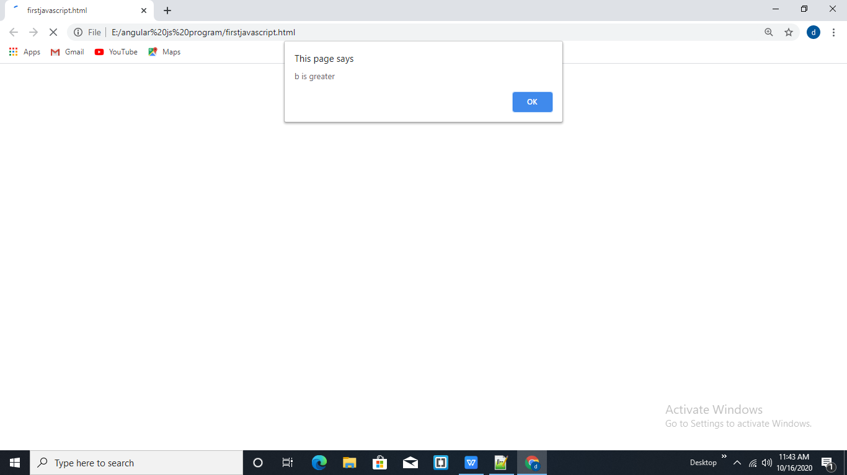
Alert Box JavaScript:
Ex:
<html>
<head>
<script>
var a=10;
var b=20;
if(a>b){
alert(“a is greater”);
}
else{
alert(“b is greater”);
}
</script>
</head>
<body>
</body>
</html>

Slide 57
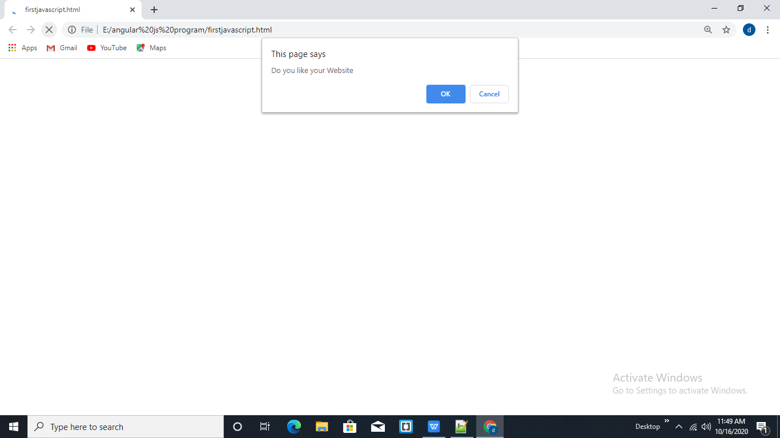
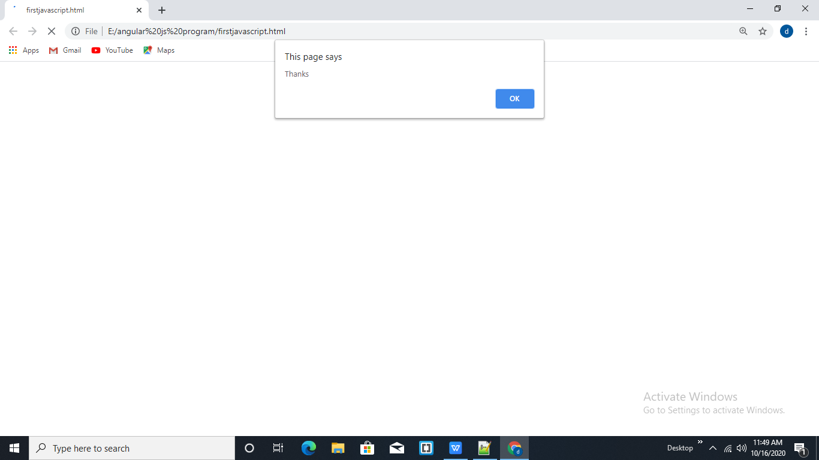
Confirm Box JavaScript:
Ex:
<html>
<head>
<script>
var a=confirm(“Do you like your Website”);
if(a){
alert(“Thanks”);
}
else{
alert(“Sorry”);
}
</script>
</head>
<body>
</body>
</html>

Slide 58
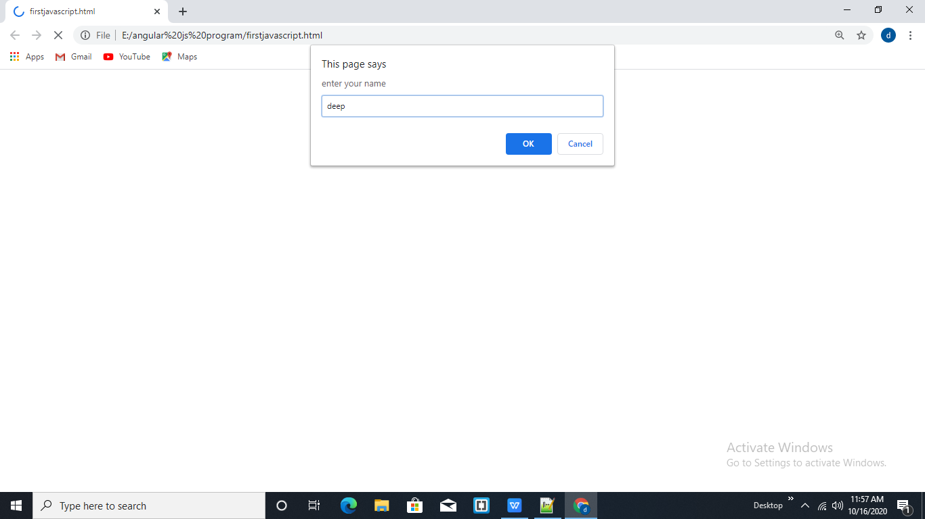
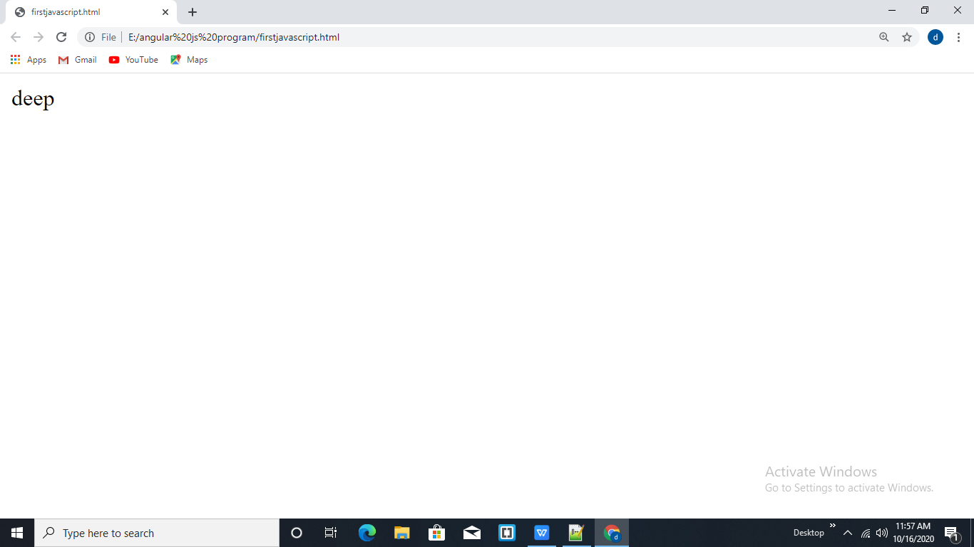
Prompt Box JavaScript:
Ex:
<html>
<head>
<script>
var a=prompt(“enter your name”);
document.write(a);
</script>
</head>
<body>
</body
</html>

Slide 59


